Slide 1
Safety and Efficacy of the BNT162b2 mRNA Covid-19 Vaccine
Affiliation with Pfizer
FP Polack., SJ Thomas, N Kitchin, et al.
Presented by Derek Scholes
Dec. 10, 2020

Slide 2
Phase II & III:
Does the BNT162b2 mRNA Covid-19 Vaccine work and is it better than what is currently available to treat Covid-19 cases?

Slide 3
Background
COVID-19 has affected tens of millions of people since the pandemic was declared by WHO on March 11, 2020.
Frontline workers and those with coexisting conditions are at highest risk.
Safe and effective prophylactic vaccines are needed to help contain this pandemic and its terrible consequences.

Slide 4
Background (cont.)
BNT162b2 mRNA Covid-19 Vaccine is a lipid nanoparticle-formulated nucleoside-modified RNA that encodes the SARS-CoV-2 full-length spike
It is modified by two proline mutations which lock the spike into a prefusion conformation.
The Phase I trials have previously been conducted.
Phase III design and conduct of trial, data collection and analysis, etc. performed by Pfizer.
BioNTech sponsored and manufactured the vaccine.

Slide 5
Study Design
Randomized, controlled
37,706 patients randomly assigned in a 1:1 ratio
18,860 received BNT162b2
Two doses 30 ug to be administered 21 days apart
Deltoid muscle
18,846 received saline placebo
Two doses 30 ug to be administered 21 days apart
Deltoid muscle

Slide 6
Inclusion and Exclusion Criteria
Eligible Patients:
16 years of age or older
Healthy or stable chronic medical conditions
Includes: HIV, Hep B, Hep C
Exclusion Criteria:
History of Covid-19
Immunosuppressive Therapy treatment
Immunocompromising diagnosis

Slide 7
Data Collection
Safety analyses to all participants who received at least one dose of either BNT162b2 or placebo.
Safety analyses performed for any local reactions, systemic events, and any adverse events after vaccination.
Covid-19 testing occurred for all participants at 7 days after second vaccination.

Slide 8
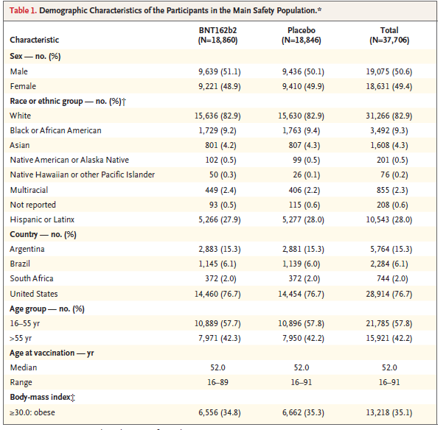
Demographics
Median Age: 52 years
Sex: 49.4% Female
Country:
USA – 76.7%
South Africa – 2%
Brazil – 6.1%
Argentina – 15.3%

Slide 9
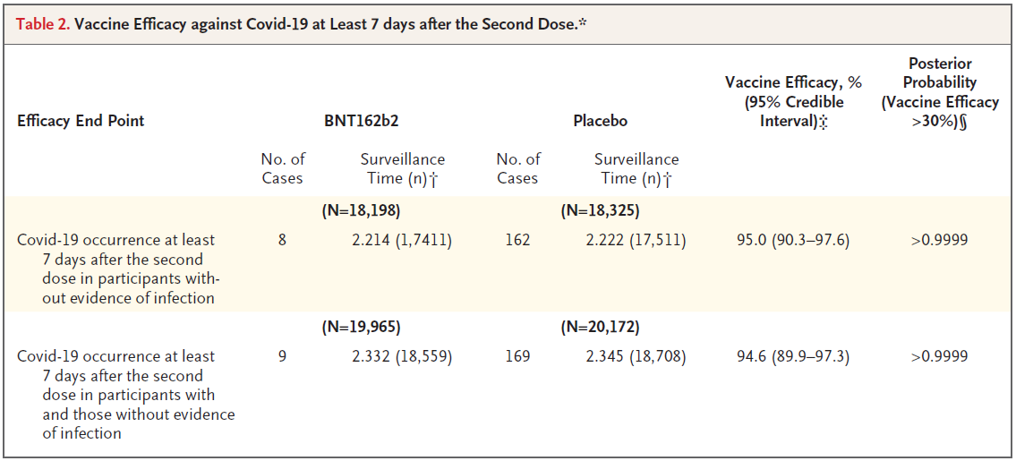
Results
Treatment with 2 doses of the vaccine shows approximately a 95% efficacy rate.
The second group includes all participant that were with or without prior infection to Covid-19.

Slide 10
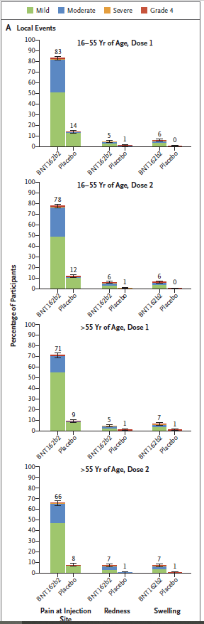
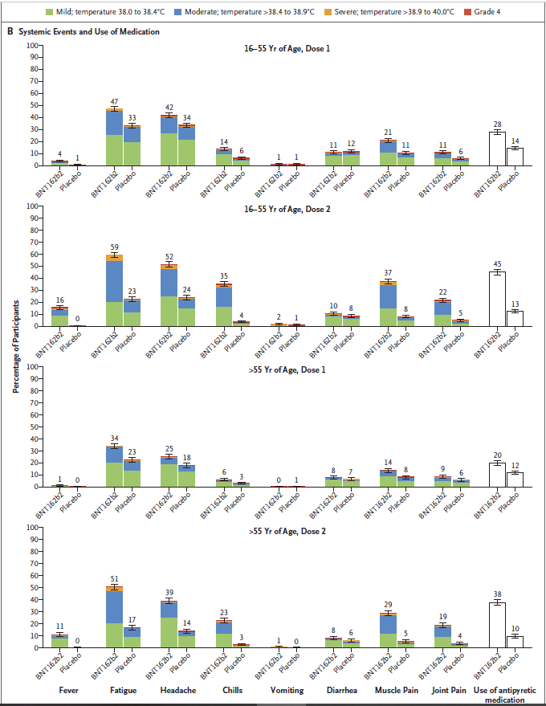
Adverse Events
Adverse events were increased amongst BNT162b2 recipients
6 deaths which were determined as unrelated to placebo (4) or treatment (2)
Severe adverse events were proportionate amongst both groups
Notes:
Any adverse events: T (27%) and T (12%)
Related adverse events: T (21%) and P (5%)
Lymphadenopathy: T (64 or 0.3%) and P (6 or <0.1%)

Slide 11
Limitations
Short follow-up period.
Not all participants received follow-ups within a 3.5-month period.
Duration of efficacy remains to be determined.
Placebo group will receive the vaccine once approved even within the 2-year follow-up period
Does not address prevention of COVID 19 in younger populations, and pregnant women.

Slide 12
Conclusion
This study shows that Covid-19 can be prevented by this 2-dose regimen and appears to be safe.
Also, this study provides a promising new approach to use RNA-based vaccines to protect humans from infectious disease.
If approved, this vaccine can help contribute to reducing the loss of health, life, and economic and social well-being that has come about from Covid-19.

Slide 13

Thank you
Any questions?

